Slide 1
Suspicious Human Activities Recognition in Railway Stations
NAME | ENROLLMENT NUMBER | EMAIL ID | SECTION | CONTACT NUMBER
Ajinkya Bedekar | U101116FCS183 | Ajinkya.Bedekar@st.niituniversity.in | C5 | 7389664860
Ankit Gupta | U101116FCS267 | Ankit.Gupta@st.niituniversity.in | C5 | 9660765363
Deeptonabho Dutta | U101116FCS030 | Deeptonabho.Dutta@st.niituniversity.in | C5 | 9674525644
Dhruva Agarwal | U101116FCS177 | Dhruva.Agarwal@st.niituniversity.in | C5 | 7339764074

Slide 2
PROBLEM IDENTIFICATION
Problem Statement:
To find out about the suspicious activities at the railway station, Indian Government decided to make the software which can read the real time video and classify the activities going on in video as suspicious or non-suspicious.
Biggest Risk:
To avoid ambiguity about whether the activity performed by human at railway station is really suspicious or not

Slide 3
TECHNOLOGIES USED
Those Taught In Class
OpenCV
Those Which Are Self-Learnt By Us
Tensorflow
YOLOv3

Slide 4
SCHEDULE
Object Detection: Learning + Implementation
Human Activity Recognition: Learning + Implementation
Final Implementation
1 February 2019
20 February 2019
10 March 2019
1 April 2019
20 April 2019
Object Tracking: Learning + Implementation
Train Software on Suspicious Activities Dataset

Slide 5
ROLES AND RESPONSIBILITIES
NAME | MODULE
Ajinkya Bedekar | Human Body Recognition
Ankit Gupta | Basic Human Activity Tracking
Deeptonabho Dutta | Defining Unambiguous Suspicious Activities In Railway Stations
Dhruva Agarwal | Training The Model

Slide 6
PROJECT PLAN FINAL

Slide 7
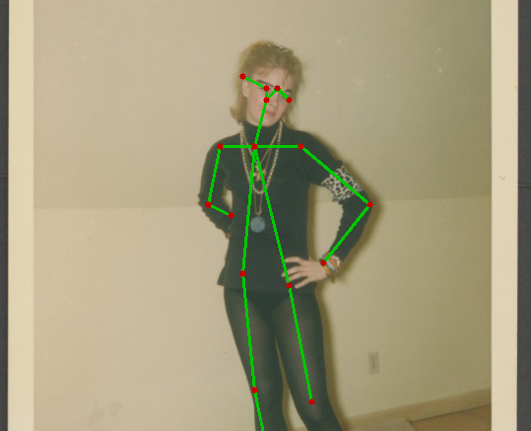
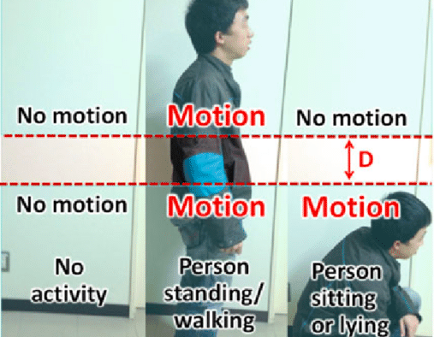
Step1: Human body recognition Step 2: Basic human activity tracking

Slide 8
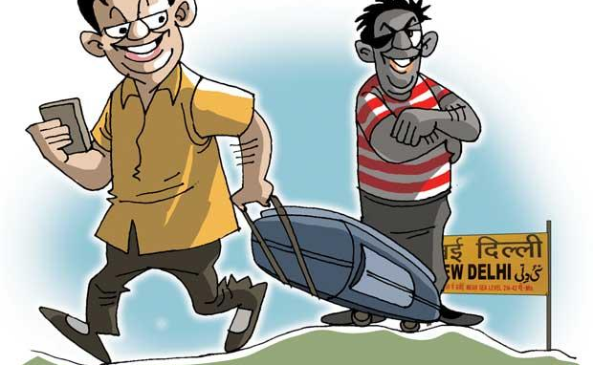
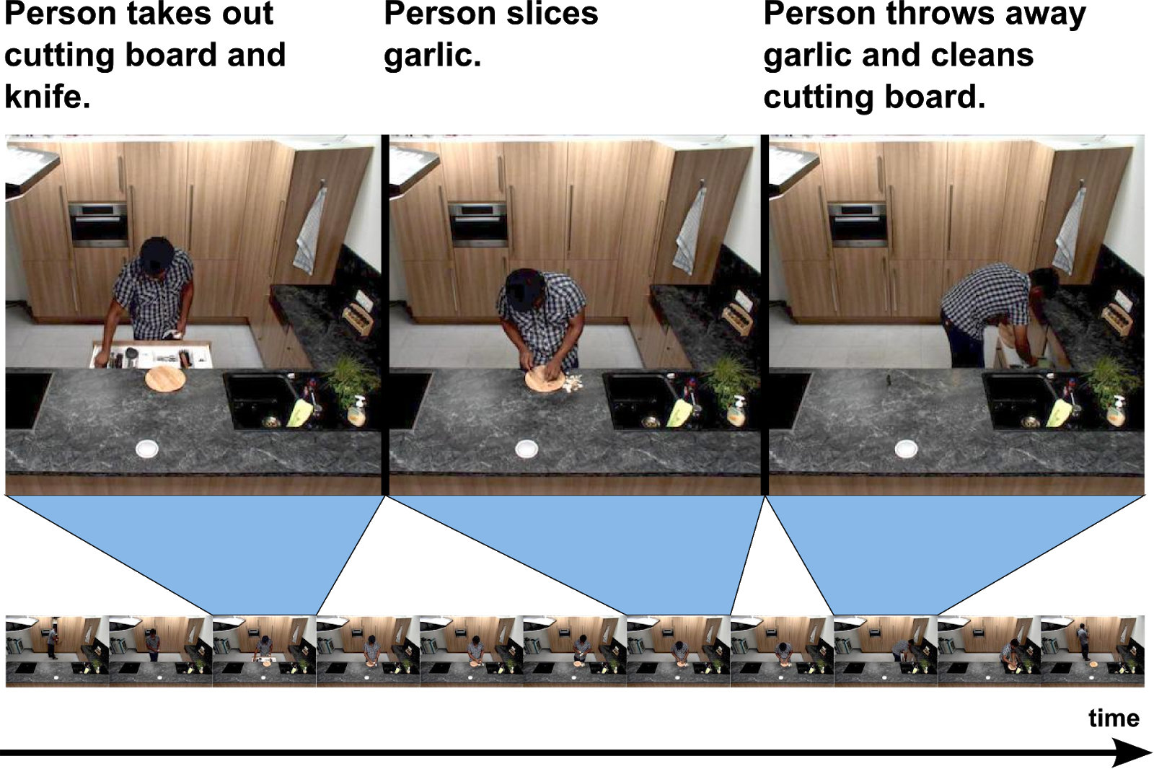
Step3: Defining unambiguous suspicious Step 4 : Training the model
activities in a railway station

Slide 9
SCOPE (Unambiguous Suspicious Activities)
Leaving the bag unattended
Snatching of objects
Crossing of railway tracks

Slide 10
WORKFLOW OF OUR SOFTWARE
Extract frame from video
Image Preprocessing
Detect Activity
Use trained model to detect suspiciousness
Yes
No
Send alert to admin
Proceed to next frame

Slide 11
METHOD OF CREATING CUSTOM MODEL
Extract image sequence from video
Image Preprocessing
Feature Extraction
Divide Dataset
Training Set
Testing Set
Build Recognition Model
Apply Model on Test Data
Repeat using other models to get best score
Evaluate Accuracy using scoring

Slide 12
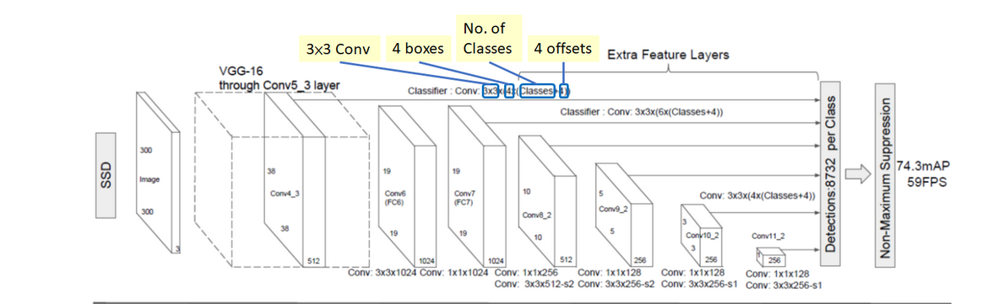
Training
SINGLE SHOT DETECTION :
SSD takes one single shot to detect multiple objects within the image

Slide 13
Model Used : SSD Mobilenet
MobileNets are a class of convolutional neural network designed by researches at Google
MobileNets split the convolution into a 3x3 depthwise conv and a 1x1 pointwise conv as opposed to traditional CNNs - a single 3x3 convolution layer followed by batch norm and ReLU
As they get bigger, the accuracy decreases

Slide 14
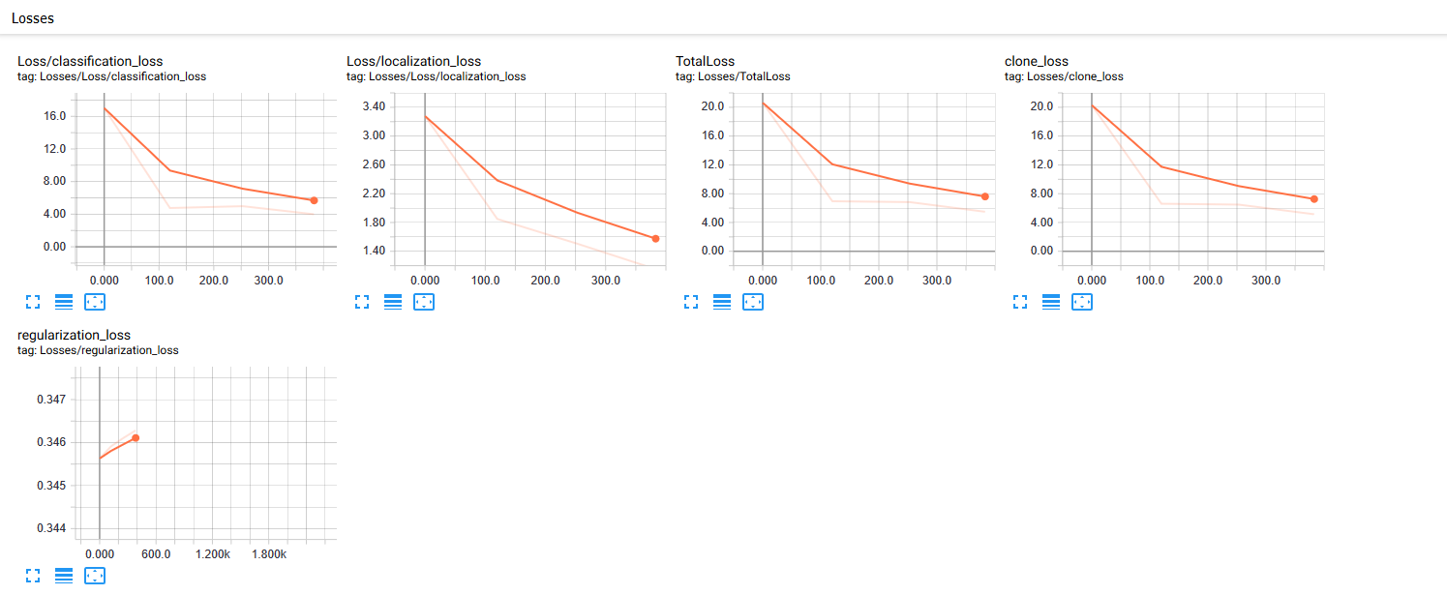
Losses (after 10 mins of training)

Slide 15
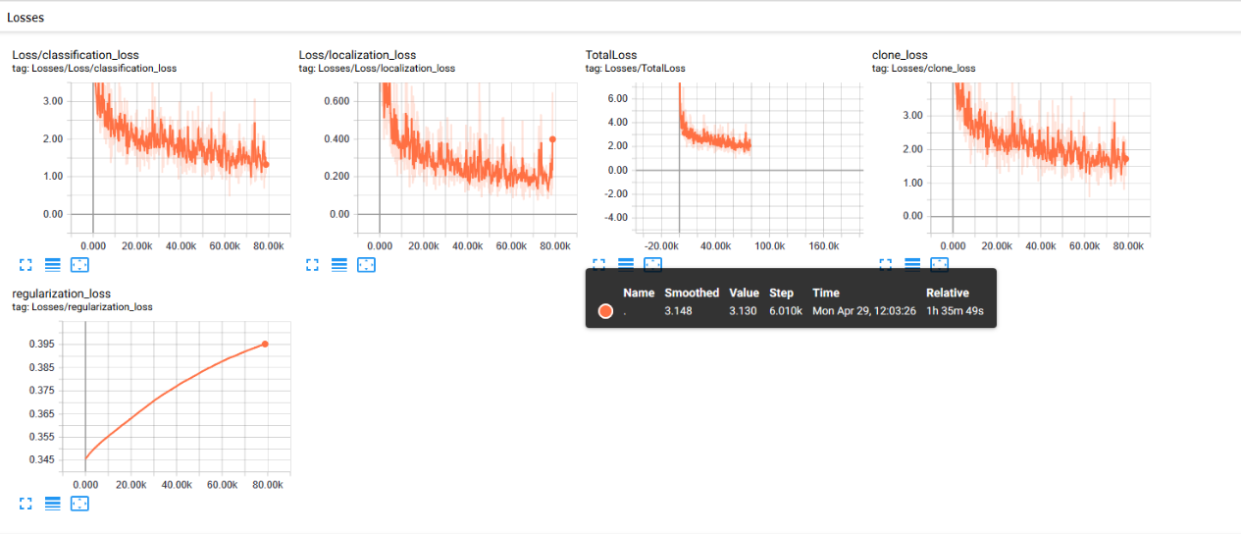
Losses(after 22 hours of training)

Slide 16
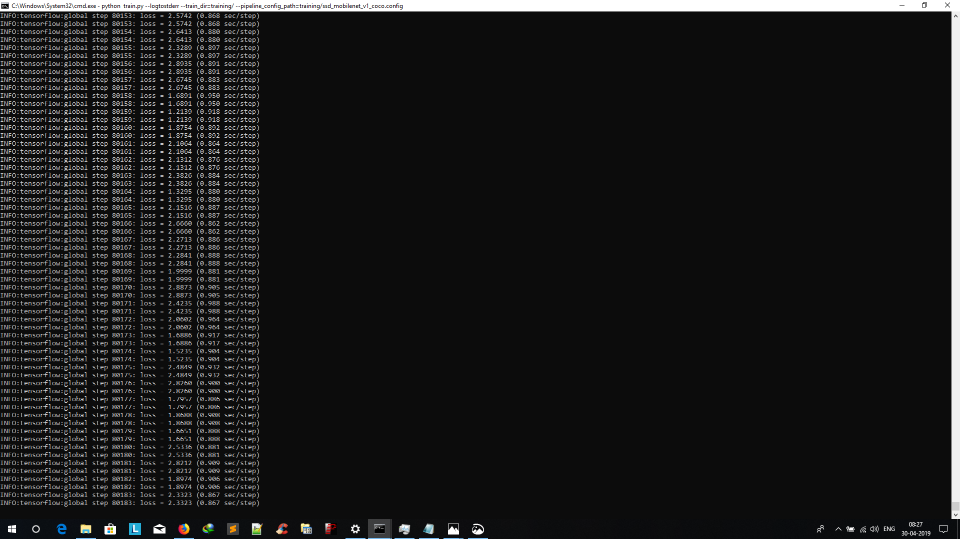

Slide 17
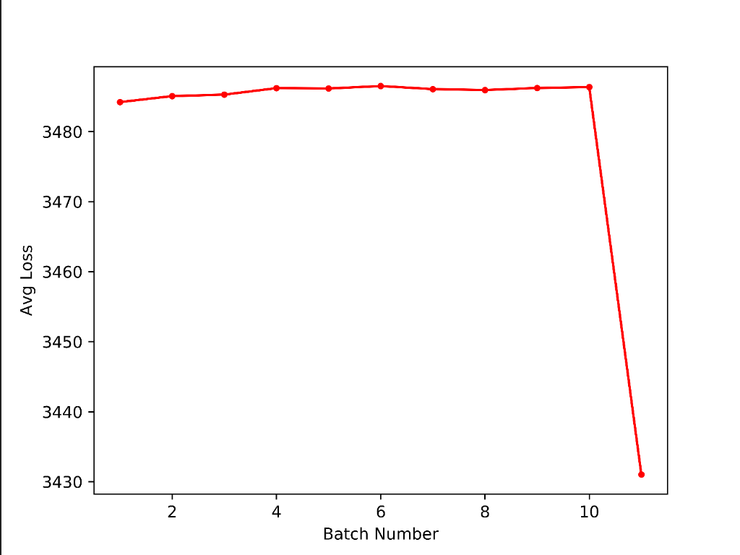
WHEN TO STOP TRAINING
We plot a graph simultaneously while training our model.
As soon as the graph drop below 1, we stop the training process.

Slide 18
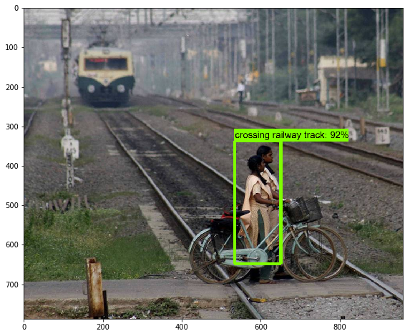
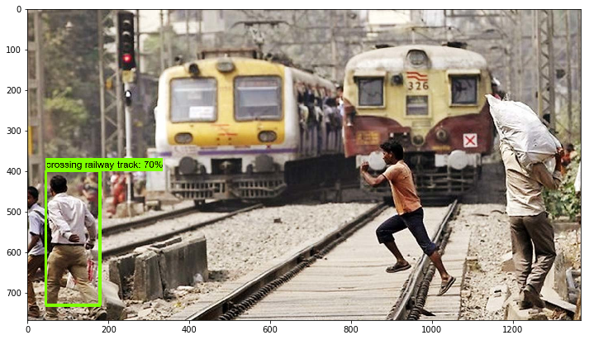
DESIGN & SOLUTION

Slide 19
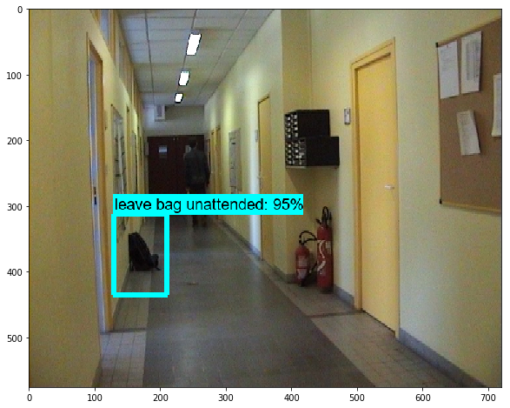

Slide 20
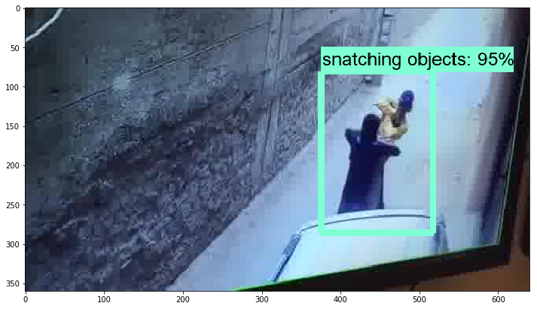

Slide 21
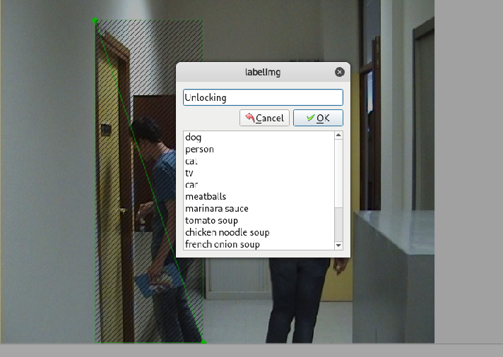
DATA ANNOTATION USING LABELIMG
We used LabelImg to label the activities in every image
After labelling, a text file is generated for every image, containing the object class number and its coordinates in the following format :
<object-class-id> <center-x> <center-y> <width> <height>

Slide 22
KNOWLEDGE GAINED
Continuous Integration and Continuous Deployment
Usage of Central Repositories
Build Tool deployment
Rigorous Unit Testing
Practical Knowledge in Computer Vision and machine learning domains

Slide 23
INDUSTRIAL DEVELOPMENT ENVIRONMENT & TOOLS
Build Tool: PyBuilder
Central Repository: GitHub
Integration: Jenkins
Infrastructure: Docker
Testing: PyBuilder / PyTest

Slide 24
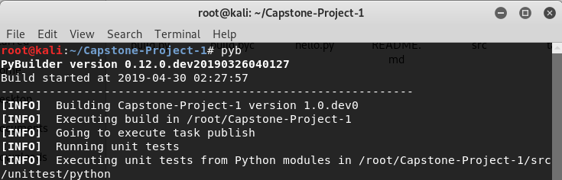
Build Tool

Slide 25
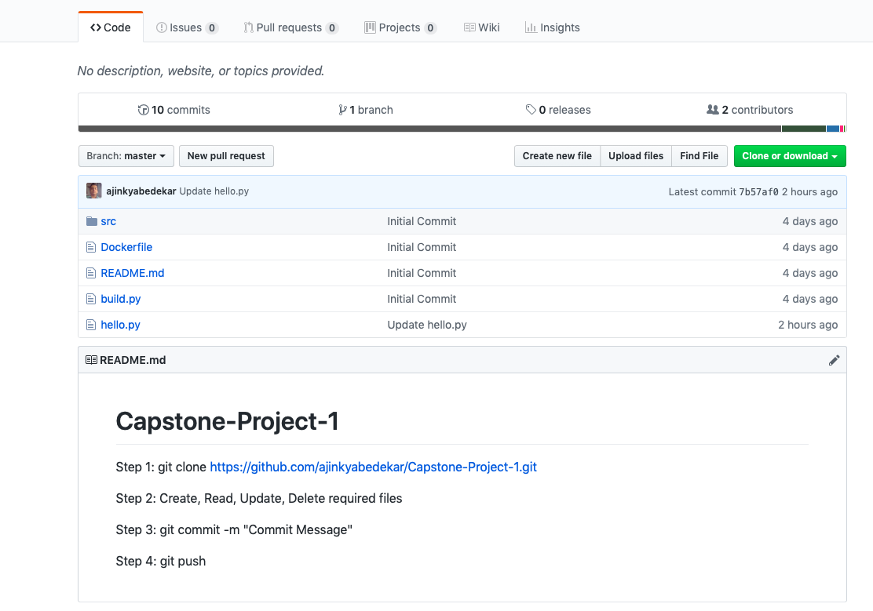
Central Repository - GITHUB

Slide 26
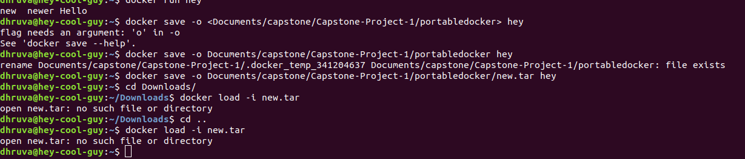
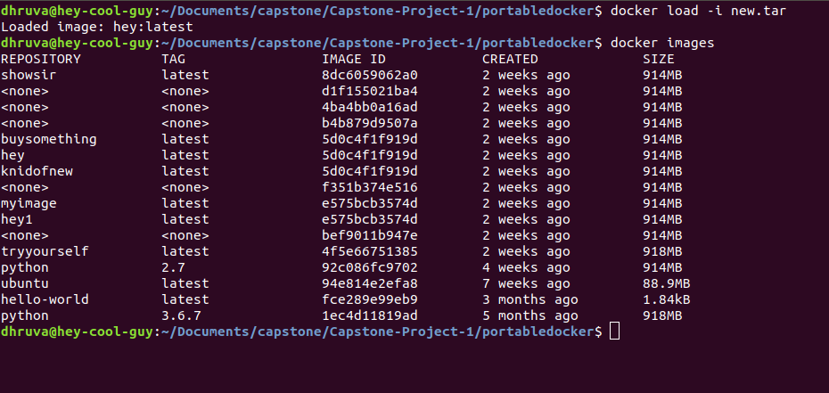
Infrastructure - Docker

Slide 27
DIFFICULTIES FACED
Building well labelled Dataset from scratch
Training Custom Model

Slide 28


